Slide 1
Clustering
School of Computer Science and Engineering
Fairleigh Dickinson University – Vancouver
Ali Safari

Slide 2
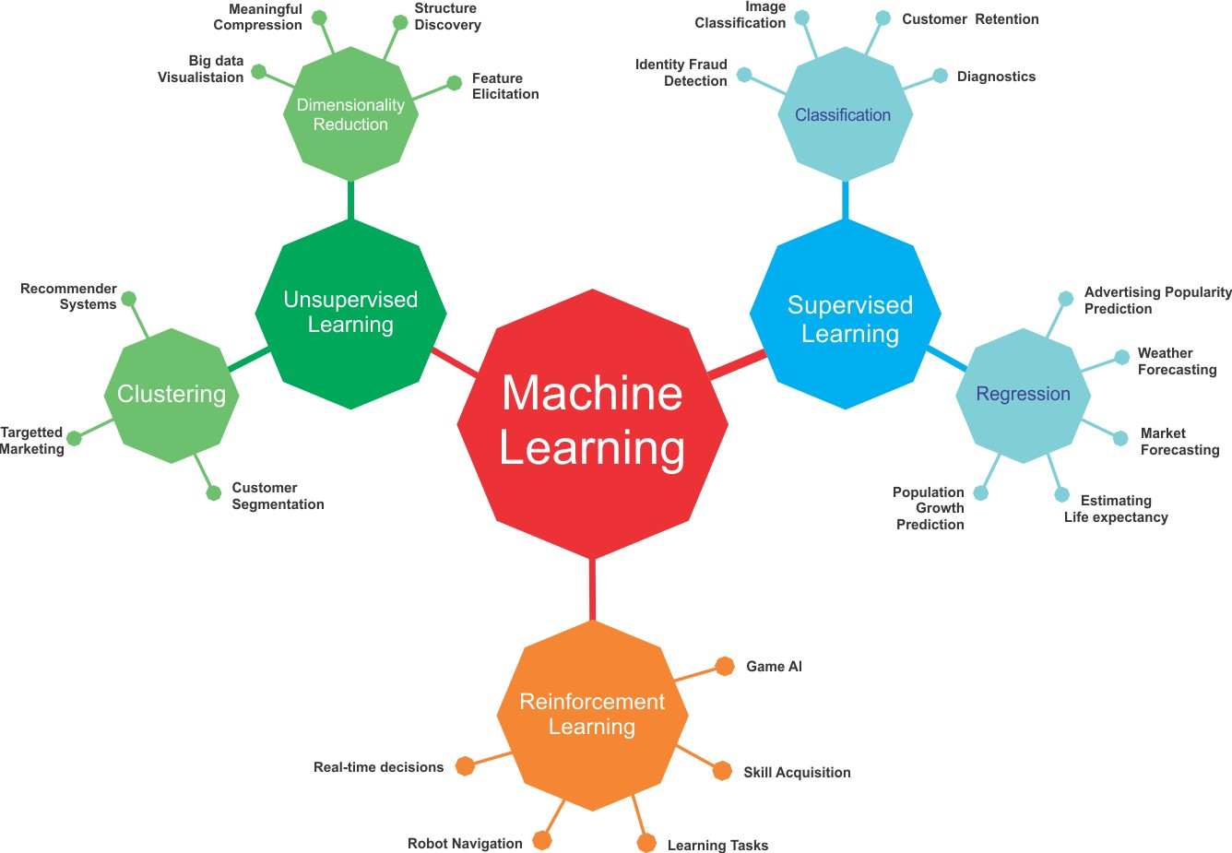
ML-Basics: What is Machine Learning?
Learning goals
Understand basic terminology of and connections between ML, AI, DL and statistics
Know the main directions of ML: Supervised, Unsupervised and Reinforcement Learning

Slide 3
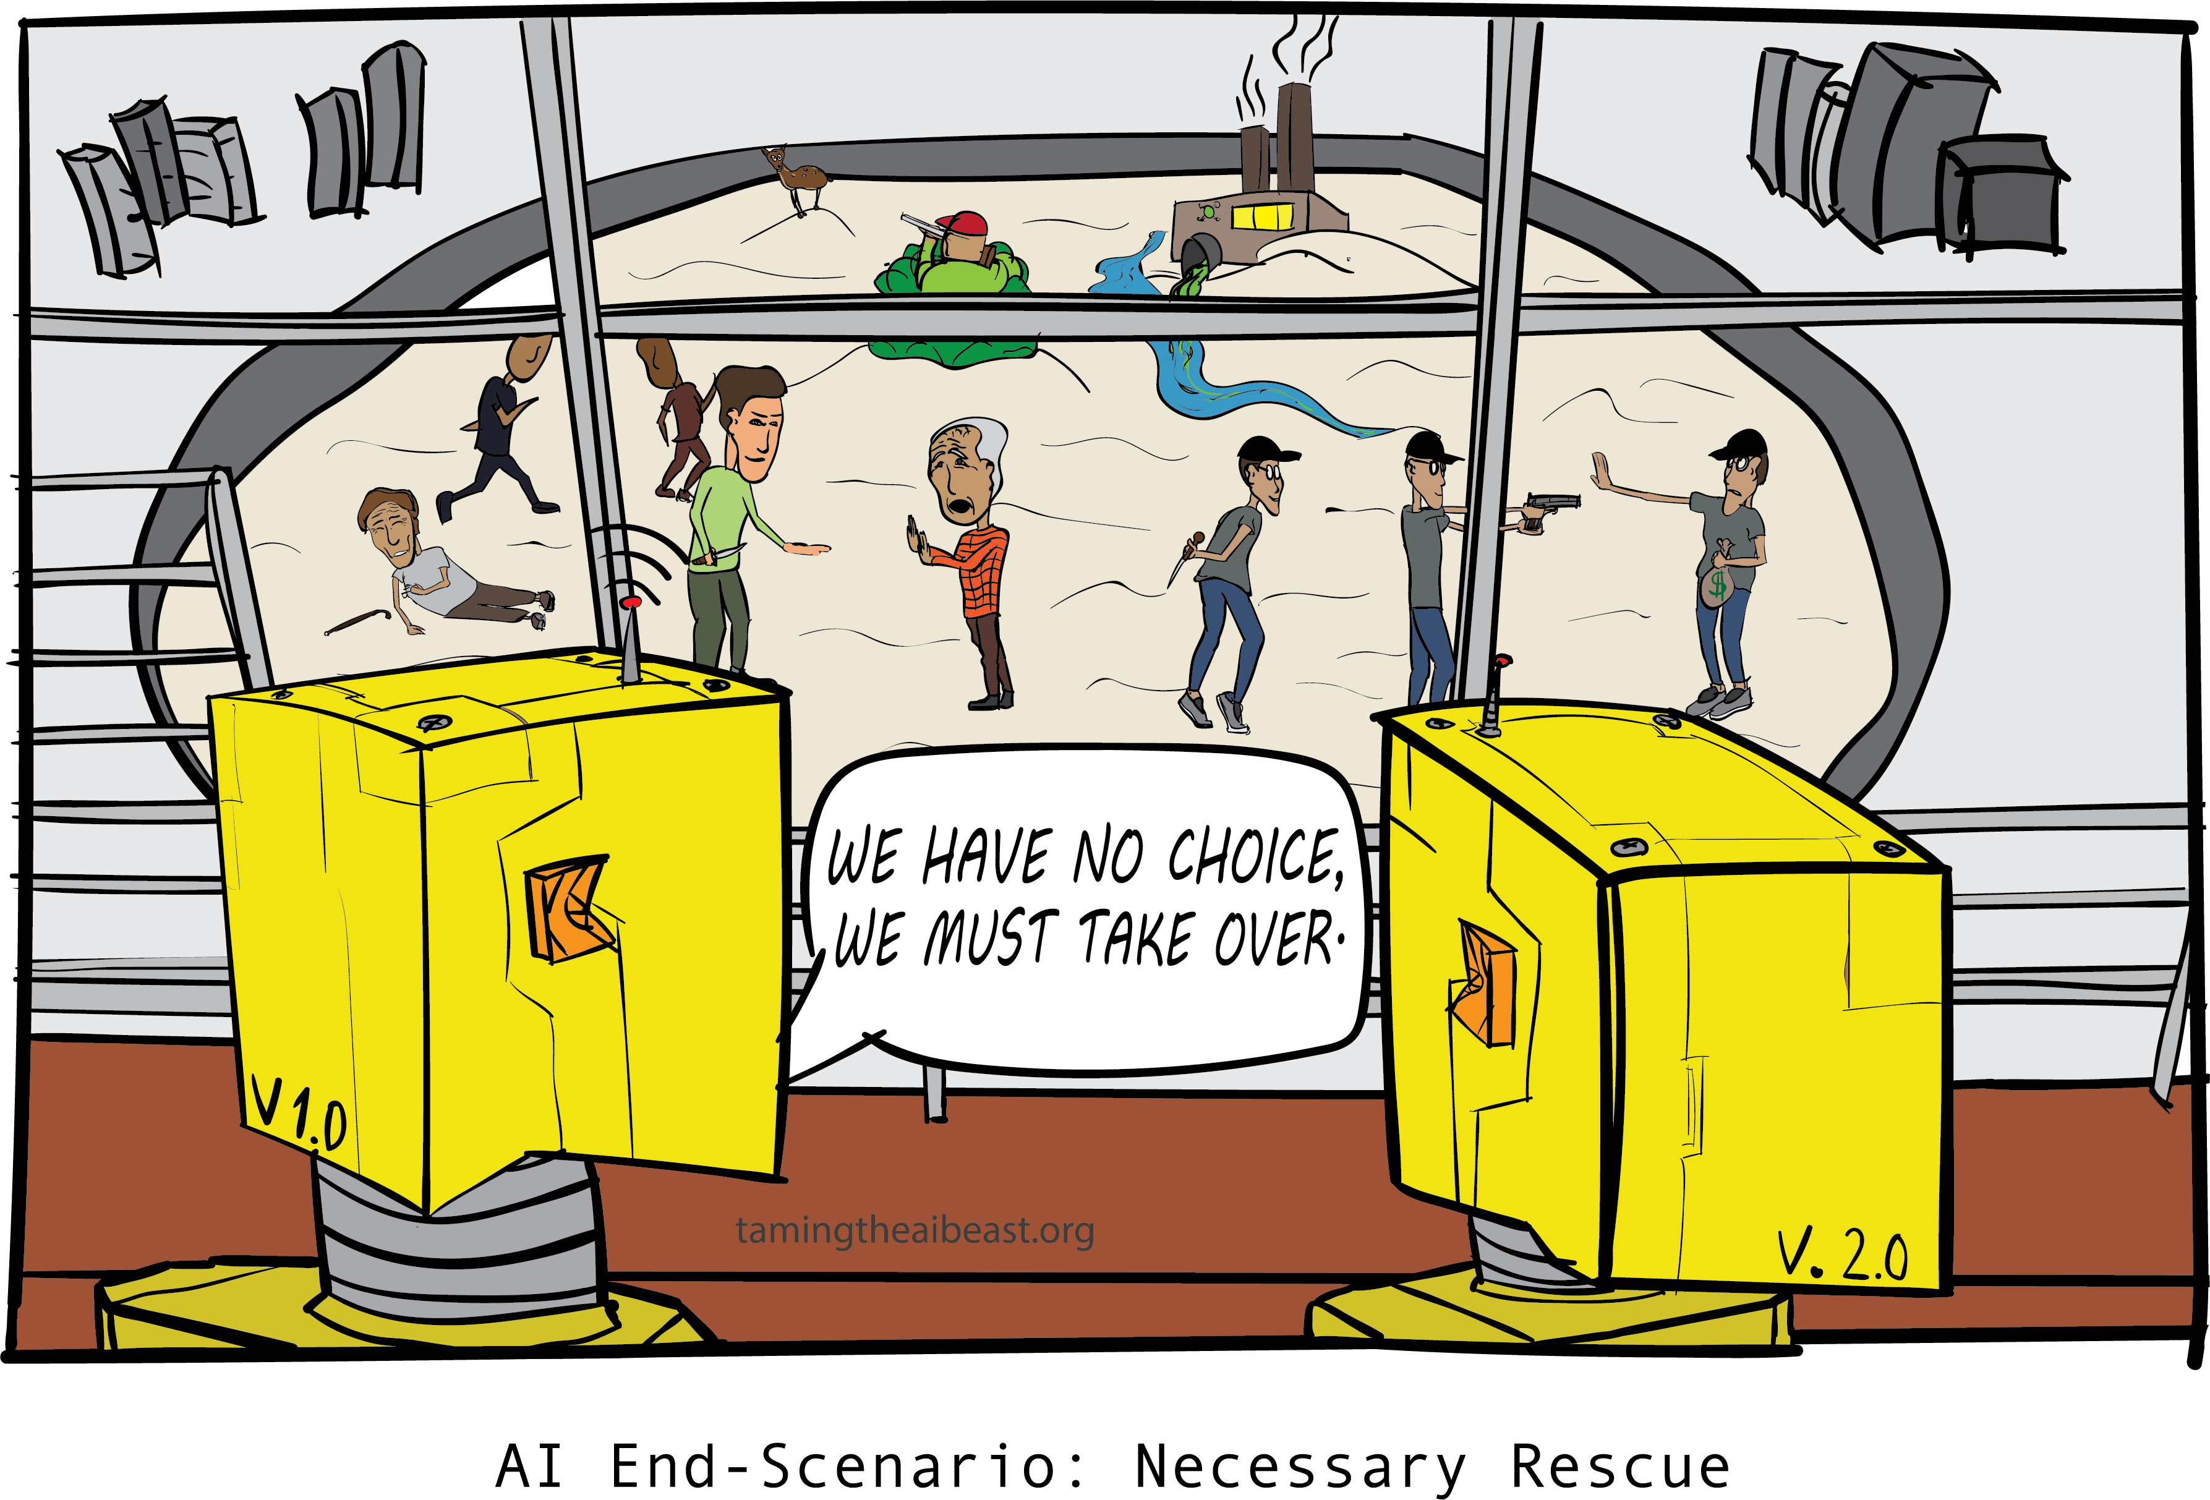
ML IS CHANGING OUR WORLD
Search engines learn your search preferences
Recommender systems learn your taste in books, music, movies,... Algorithms do automatic stock trading
Tools can accurately translate between many different languages DeepMind beats humans at Go
Physicians are supported by personalized medicine
LLMs revolutionize many fields (currently especially coding) Data-driven discoveries are made in physics, biology, genetics, astronomy, chemistry, neurology,...
...

Slide 4
AI, ML AND DL
Artificial Intelligence
Machine Learning
Deep Learning
Many people are confused what these terms actually mean.
And what does all this have to do with statistics?

Slide 5

ARTIFICIAL INTELLIGENCE
General term for very large and rapidly developing field.
No strict definition, but often used when machines perform tasks that could only be solved by humans or are very difficult and assumed to require “intelligence”.
Started in the 1940s – when the computer was invented. Turing and von Neumann immediately asked: If we can formalize computation, can we use that to formalize “thinking”?
Includes ML, NLP, computer vision, robotics, planning, search, intelligent agents, ...
Sometimes misused as a “hype” term for ML or ... basic data analysis.
Or people refer to the fascinating developments in the area of foundation models

Slide 6
MACHINE LEARNING
Mathematically well-defined and solves reasonably narrow tasks.
Usually construct predictive models from data, instead of explicitly programming them.
“A computer program is said to learn from experience E with respect to some task T and some performance measure P, if its performance on T, as measured by P, improves with experience E.”
Tom Mitchell, Carnegie Mellon University, 1998

Slide 7

DEEP LEARNING
Subfield of ML which studies neural networks.
Artificial neural networks are roughly inspired by the human brain, but we treat them as useful, mathematical models.
Studied for decades (start in the 1940/50s).Uses more layers, might use specific neurons, e.g., for images, many computational improvements to train on large data.
Can be used on tabular data, but typical applications are images, texts or signals.
Last 15-20 years have produced remarkable results and imitations of human ability, where the result looked intelligent.
“Any sufficiently advanced technology is indistinguishable from magic.” Arthur C. Clarke’s 3rd law

Slide 8
Types of Learning

Slide 9
Types of Learning
Supervised (inductive) learning
Given: training data + desired outputs (labels)
Unsupervised learning
Given: training data (without desired outputs)
Semi-supervised learning
Given: training data + a few desired outputs
Reinforcement learning
Rewards from sequence of actions

Slide 10



Supervised Learning: Regression
Given (x₁, y₁), (x₂, y₂), ..., (x_{n}, y_{n})
Learn a function f(x) to predict y given x
– y is real-valued == regression
9
8
7
6
5
4
3
2
1
0
1970 1980
September Arctic Sea Ice Extent (1,000,000 sq km)
1990 2000
2010
2020
Year

Slide 11










Supervised Learning: Classification
Given (x₁, y₁), (x₂, y₂), ..., (x_{n}, y_{n})
Learn a function f(x) to predict y given x
– y is categorical == classification
Breast Cancer (Malignant / Benign)
1(Malignant)
0(Benign)
Tumor Size

Slide 12








Supervised Learning: Classification
Given (x₁, y₁), (x₂, y₂), ..., (x_{n}, y_{n})
Learn a function f(x) to predict y given x
– y is categorical == classification
Breast Cancer (Malignant / Benign)
1(Malignant)
0(Benign)
Tumor Size
Predict Benign Predict Malignant
Tumor Size

Slide 13











Supervised Learning
x can be multi-dimensional
– Each dimension corresponds to an attribute
Clump Thickness
Uniformity of Cell Size
Uniformity of Cell Shape
…
Age
Tumor Size

Slide 14
















Unsupervised Learning
Given x₁, x₂, ..., x_{n} (without labels)
Output hidden structure behind the x’s
– E.g., clustering

Slide 15
UNSUPERVISED LEARNING
Data without labels y
Search for patterns within the inputs x
Unsupervised as there is no “true” output we can optimize against
2.5
● ●●●
Dimensionality reduction (PCA, autoencoders ...);
compress information in X
Clustering: group similar observations
Outlier detection, anomaly detection
Association rules
●●●●●●●● ●
●●●● ●
●●●●●●● ●
2.0
●●
●●●●●●●●●
●●●
● ●
Petal.Width
●●● ●
1.5
●●●●●●
● ●●● ●
●●●●●●●
●
●●●●●●
1.0
●●●●●●
●
0.5
●
●●●●●
●●●●●●●●●●
0.0
●●●
2
4
Petal.Length
6

Slide 16
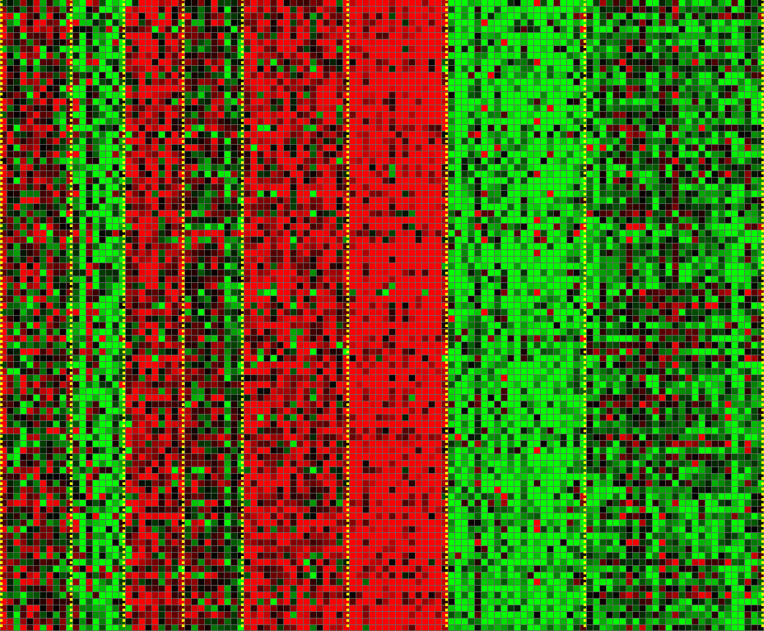
Unsupervised Learning
Genomics application: group individuals by genetic similarity
Genes
Individuals

Slide 17

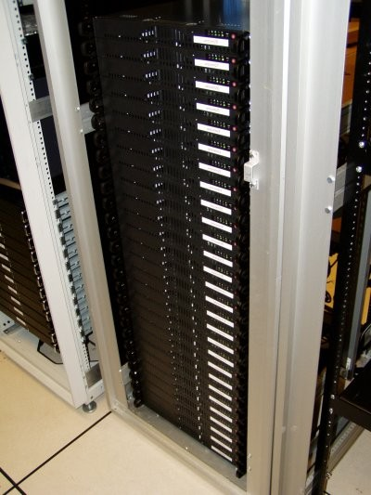
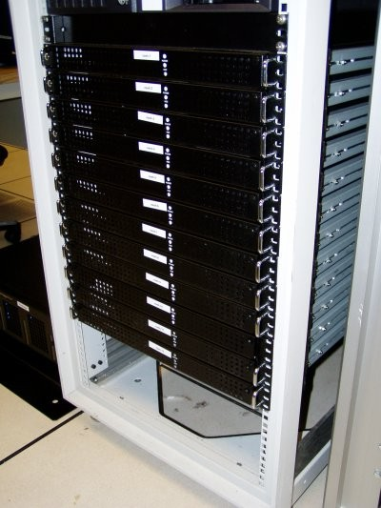




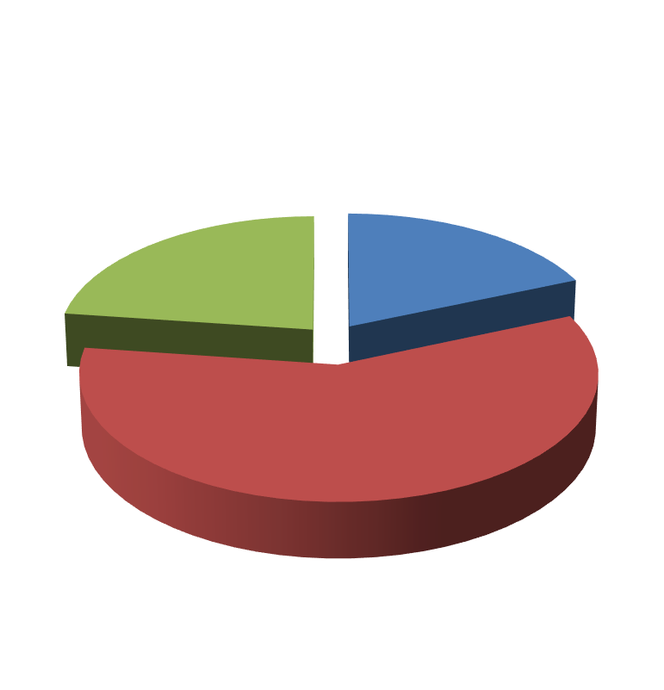

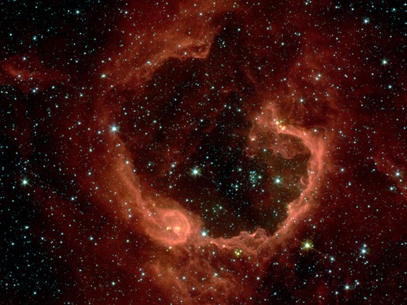


Unsupervised Learning
Organize computing clusters
Social network analysis
Market segmentation
Image credit: NASA/JPL-Caltech/E. Churchwell (Univ. of Wisconsin, Madison)
Astronomical data analysis

Slide 18
Reinforcement Learning
Given a sequence of states and actions with (delayed) rewards, output a policy
Policy is a mapping from states ➔ actions that tells you what to do in a given state
Examples:
Credit assignment problem
Game playing
Robot in a maze
Balance a pole on your hand

Slide 19
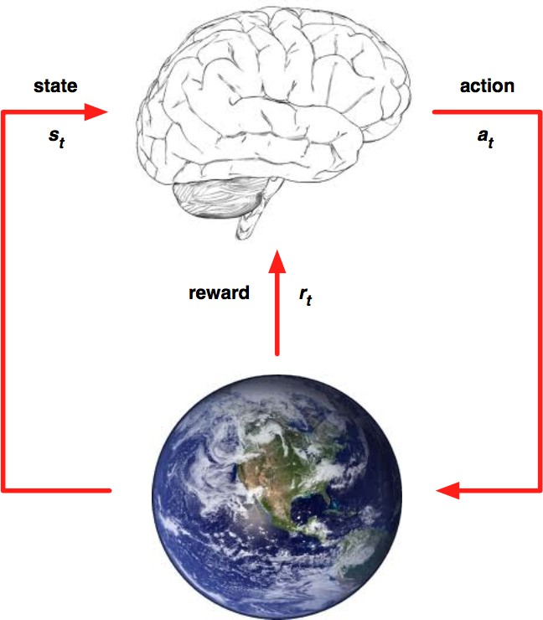
REINFORCEMENT LEARNING
General-purpose framework. At each time step an agent interacts with an environment. It: observes state; receives reward; executes action.
Goal: Select actions to maximize future reward. Reward signals may be sparse, noisy and delayed.

Slide 20
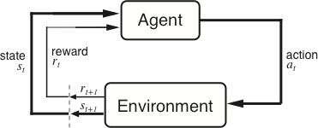
The Agent-Environment Interface
Agent and environment interact at discrete time steps Agent observes state at step t : s_{t} ∈S
: t = 0, 1, 2, K
produces action at step t : a_{t} ∈ A(s_{t} )
gets resulting reward : and resulting next state :
r_{t +1} ∈ℜ
^{s}t +1
. . .
^{r}t +1 _{st +1}
^{r}t +2 _{st +2}
^{r}t +3
. . .
s
t
a_{t}
^{s}t +3
ªt +1
ªt +2
ªt +3

Slide 21
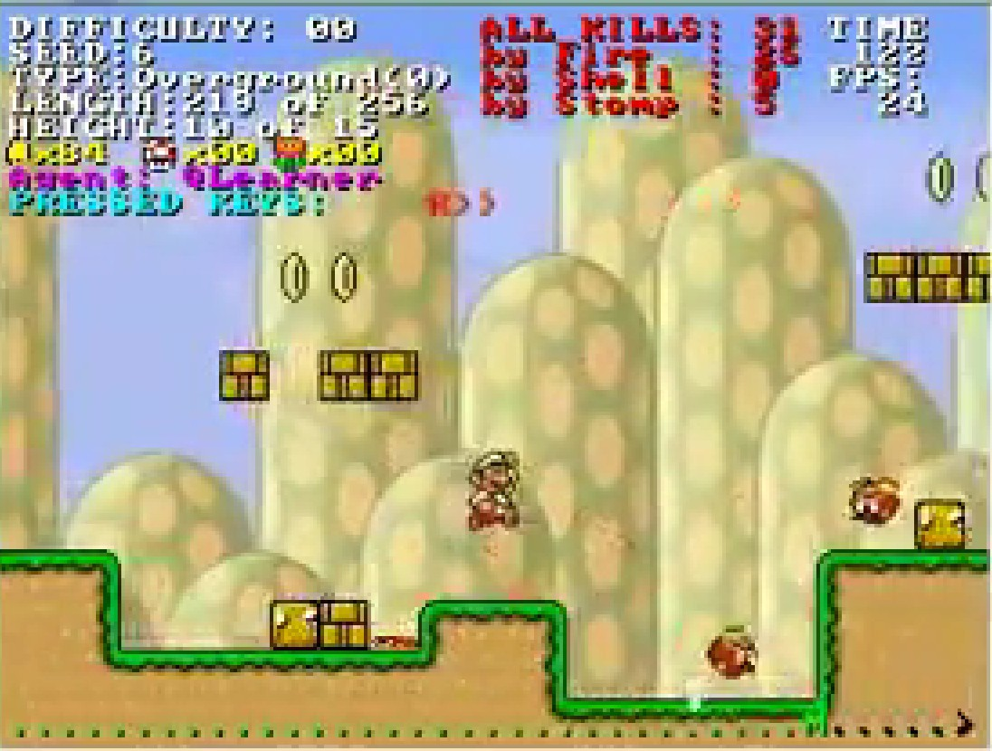
Reinforcement Learning
https://www.youtube.com/watch?v=4cgWya-wjgY

Slide 22

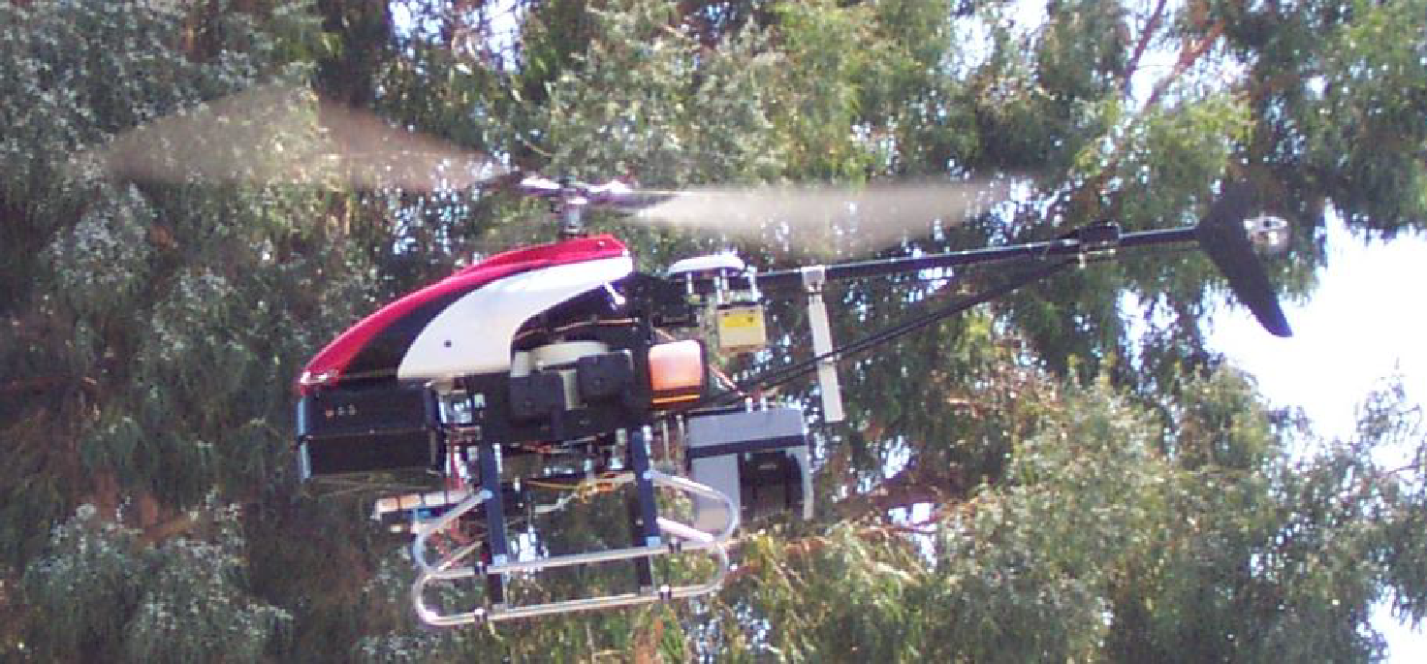
Inverse Reinforcement Learning
Learn policy from user demonstrations
Stanford Autonomous Helicopter http://heli.stanford.edu/ https://www.youtube.com/watch?v=VCdxqn0fcnE

Slide 23
High Dimensional Data
High dim. data
Locality sensitive hashing
Clustering
Graph data
PageRank, SimRank
Community Detection
Infinite data
Filtering data streams
Web advertising
Dimensionality reduction
Spam Detection
Queries on streams
Machine learning
SVM
Decision Trees
Perceptron, kNN
Apps
Recommender systems
Association Rules
Duplicate document detection

Slide 24
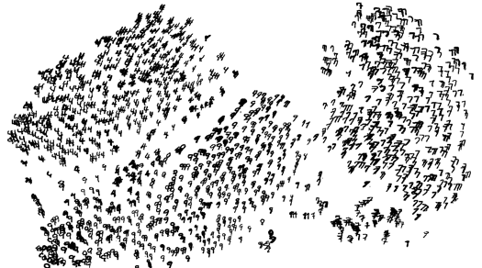
Unsupervised Learning: Cluastering
Given a cloud of data points we want to understand its structure

Slide 25
The Problem of Clustering
Given a set of points, with a notion of distance between points, group the points into some number of clusters, so that
Members of a cluster are close/similar to each other
Members of different clusters are dissimilar
Usually:
Points are in a high-dimensional space
Similarity is defined using a distance measure
Euclidean, Cosine, Jaccard, edit distance, …

Slide 26
Example: Clusters & Outliers
x
xx x
x x
x x x
x
x x x
x
x
xx x
x x
x x x
x
x x x
x
x
x x
x x x x
x x x x
x x x
x x
x x
x x x x
x x x x
x x x
x x
x x
x x x x
x x x
x
x x
x x x x
x x x
x
x
Outlier
Cluster

Slide 27
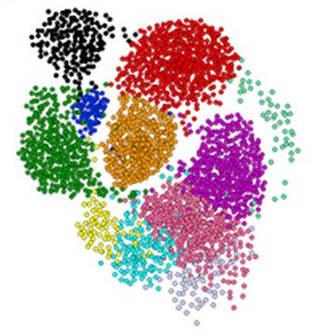
Clustering is a hard problem!

Slide 28
Why is it hard?
Clustering in two dimensions looks easy
Clustering small amounts of data looks easy
And in most cases, looks are not deceiving
Many applications involve not 2, but 10 or 10,000 dimensions
High-dimensional spaces look different: Almost all pairs of points are at about the same distance --> The Curse of Dimensionality!

Slide 29
Example: Curse of dimensionality
Take 10,000 uniform random points on [0,1] line. Assume query point is at the origin
What fraction of “space” do we need to cover to
get 0.1% of data (10 nearest neighbors)
In 1-dim to get 10 neighbors we must go to distance 10/10,000=0.001 on the average
In 2-dim we must go 0.001=0.032 to get a square that contains 0.001 volume
In general, in d-dim we must go
So, in 10-dim to capture 0.1% of the data we need 50% of the range.

Slide 30
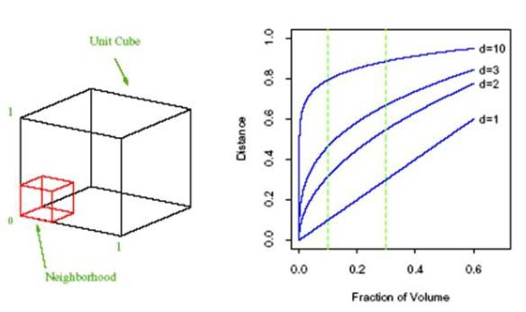
Curse of Dimensionality: All points are very far from each other

Slide 31
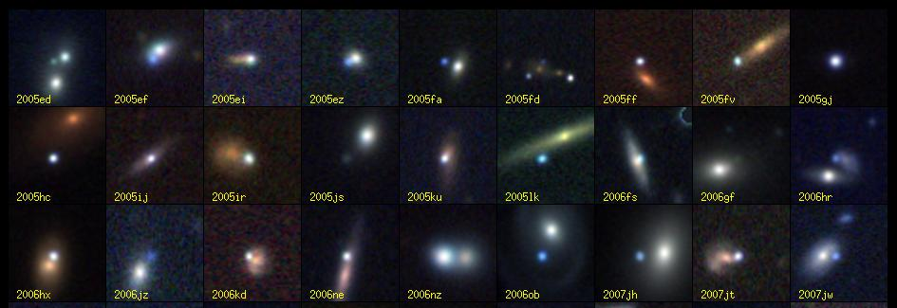
Clustering Problem: Galaxies
A catalog of 2 billion “sky objects” represents objects by their radiation in 7 dimensions (frequency bands)
Problem: Cluster into similar objects, e.g., galaxies, nearby stars, quasars, etc.
Sloan Digital Sky Survey

Slide 32
Clustering Problem: Music CDs
Intuitively: Music divides into categories, and customers prefer a few categories
But what are categories really?
Represent a CD by a set of customers who bought it:
Similar CDs have similar sets of customers, and vice-versa

Slide 33
Clustering Problem: Music CDs
Space of all CDs:
Think of a space with one dim. for each customer
Values in a dimension may be 0 or 1 only
A CD is a point in this space (x₁, x₂,…, x_{k}), where x_{i} = 1 iff the i ^{th} customer bought the CD
For Amazon, the dimension is tens of millions
Task: Find clusters of similar CDs

Slide 34
Clustering Problem: Documents
Finding topics:
Represent a document by a vector (x₁, x₂,…, x_{k}), where x_{i} = 1 iff the i ^{th} word (in some order) appears in the document
It actually doesn’t matter if k is infinite; i.e., we don’t limit the set of words
Documents with similar sets of words may be about the same topic

Slide 35
Cosine, Jaccard, and Euclidean
As with CDs we have a choice when we think of documents as sets of words or shingles:
Sets as vectors: Measure similarity by the cosine distance
Sets as sets: Measure similarity by the Jaccard distance
Sets as points: Measure similarity by Euclidean distance

Slide 36
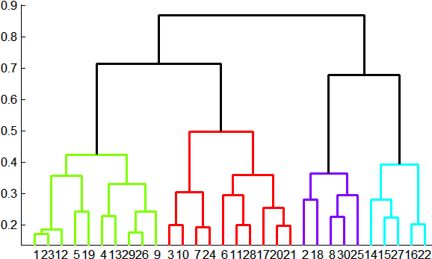
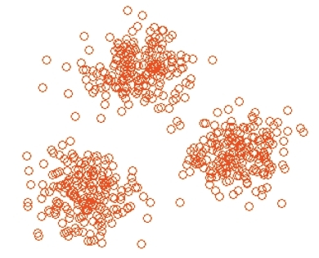
Overview: Methods of Clustering (1)
Hierarchical:
Agglomerative (bottom up):
Initially, each point is a cluster
Repeatedly combine the two “nearest” clusters into one
Divisive (top down):
Start with one cluster and recursively split it
Point assignment:
Maintain a set of clusters
Points belong to “nearest” cluster

Slide 37
Overview: Methods of Clustering(2)
Is the space Euclidean or non-Euclidean?
In Euclidean:
Points are vectors of real numbers, i.e. coordinates
It is possible to summarize a collection of points as their average. We call it centroid.
Distance measure: L2 norm, L1 norm
In non-Euclidean:
There is no notion of location, and centroid
We summarize a collection of points differently
Distance measures: Jaccard, Hamming, cosine

Slide 38
Overview: Methods of Clustering(3)
In-memory clustering is more straightforward
Example: K-means
Large-data clustering requires loading one batch of data at a time, cluster them in memory and keep summaries of clusters
Example: BFR, CURE

Slide 39









Hierarchical vs point-assignment
Point assignment good when clusters are nice, convex shapes:
Hierarchical can win when shapes are weird:
Note both clusters have essentially the same centroid.
Aside: if you realized you had concentric clusters, you could map points based on distance from center, and turn the problem into a simple, one-dimensional case.

Slide 40



Slide 41
Hierarchical Clustering
Key operation: Repeatedly combine two nearest clusters
Three important questions:
1) How do you represent a cluster of more than one point?
2) How do you determine the “nearness” of clusters?
3) When to stop combining clusters?

Slide 42
Hierarchical Clustering
Key operation: Repeatedly combine two nearest clusters
(1) How to represent a cluster of many points?
Key problem: As you merge clusters, how do you represent the “location” of each cluster, to tell which pair of clusters is closest?
Euclidean case: each cluster has a centroid = average of its (data)points
(2) How to determine “nearness” of clusters?
Measure cluster distances by distances of centroids

Slide 43
Example: Hierarchical clustering
(5,3)
o
(1,2)
o
o (2,1) o (4,1)
o (0,0) o (5,0)
x (1.5,1.5)
x (4.7,1.3)
x (1,1)
x (4.5,0.5)
Data:
o … data point
x … centroid
Dendrogram

Slide 44
And in the Non-Euclidean Case?
What about the Non-Euclidean case?
The only “locations” we can talk about are the points themselves
i.e., there is no “average” of two points
Approach 1:
(1) How to represent a cluster of many points? clustroid = (data)point “closest” to other points
(2) How do you determine the “nearness” of clusters? Treat clustroid as if it were centroid, when computing inter-cluster distances

Slide 45
“Closest” Point?
(1) How to represent a cluster of many points? clustroid = point “closest” to other points
Possible meanings of “closest”:
Smallest maximum distance to other points
Smallest average distance to other points
Smallest sum of squares of distances to other points
For distance metric d clustroid c of cluster C is:
Datapoint
Centroid
X
Centroid is the avg. of all (data)points in the cluster. This means centroid is an “artificial” point.
Clustroid is an existing (data)point that is “closest” to all other points in the cluster.
Clustroid
Cluster on 3 datapoints

Slide 46
Defining “Nearness” of Clusters
(2) How do you determine the “nearness” of clusters?
Approach 2: Intercluster distance = minimum of the distances between any two points, one from each cluster
Approach 3: Pick a notion of “cohesion” of clusters, e.g., maximum distance from the clustroid
Merge clusters whose union is most cohesive

Slide 47
Cohesion
Approach 3.1: Use the diameter of the merged cluster = maximum distance between points in the cluster
Approach 3.2: Use the average distance between points in the cluster
Approach 3.3: Use a density-based approach
Take the diameter or avg. distance, e.g., and divide by the number of points in the cluster

Slide 48

When do we stop merging clusters?
When some number 𝑘 of clusters are found (assumes we know the number of clusters)
When stopping criterion is met
Stop if diameter exceeds threshold
Stop if density is below some threshold
Stop if merging clusters yields a bad cluster
E.g., diameter suddenly jumps
Keep merging until there is only 1 cluster left

Slide 49
It really depends on the shape of clusters.
Which you may not know in advance.
Example: we’ll compare two approaches:
Merge clusters with smallest distance between centroids (or clustroids for non-Euclidean)
Merge clusters with the smallest distance between two points, one from each cluster

Slide 50



Centroid-based merging works well.
But merger based on
closest members might accidentally merge incorrectly.
C
A
B
A and B have closer centroids than A and C, but closest points are from A and C.
Data density

Slide 51
Linking based on closest members works well
But Centroid-based linking might cause errors
1/18/22
Jure Leskovec, Stanford CS246: Mining Massive Datasets
31

Slide 52
Implementation
Naïve implementation of hierarchical clustering:
At each step, compute pairwise distances between all pairs of clusters, then merge
O(N³)
Careful implementation using priority queue can reduce time to O(N² log N)
Still too expensive for really big datasets that do not fit in memory

Slide 53
k-means clustering

Slide 54
k–means Algorithm(s)
It is a problem formulation, not an algorithm.
Problem: Given Euclidean space/distance and k = number of clusters, find cluster centers that minimizes sum of squared distances from each point to its cluster center
Finding an exact solution is NP-hard.
The approximate solution is LIoyd’s algorithm or the k-means algorithm.

Slide 55
k–means Algorithm(s)
Assumes Euclidean space/distance
Start by picking k, the number of clusters
Initialize clusters by picking one point per cluster
Example: Pick one point at random, then k-1 other points, each as far away as possible from the previous points

Slide 56
Populating Clusters
1) Initialize clusters by picking k centers
Until convergence:
2) For each point, assign it to the cluster whose current centroid is the closest
3) After all points are assigned, update the centroids of the k clusters as average of data points within each cluster
Repeat 2 and 3 until convergence
Convergence: Points don’t move between clusters and centroids stabilize

Slide 57
Example: Assigning Clusters
x
x
x
x
x
x
x
x
x
x
x
x … data point
… centroid
Clusters after round 1

Slide 58
Example: Assigning Clusters
x
x
x
x
x
x
x
x
x
x
x
x … data point
… centroid
Clusters after round 2

Slide 59
Example: Assigning Clusters
x
x
x
x
x
x
x
x
x
x
x
x … data point
… centroid
Clusters at the end

Slide 60
Getting the k right
How to select k?
Try different k, looking at the change in the average distance to centroid as k increases
Average falls rapidly until right k, then changes little
Best value
of k
Average
distance to
centroid
k

Slide 61
Example: Picking k
x
xx x
x x
x x x
x
x x x
x
Too few;
many long
distances
to centroid.
x
x x
x x x x
x x x x
x x x
x x
x x
x x x x
x x x
x
x

Slide 62
Example: Picking k
x
xx x
x x
x x x
x
x x x
x
x
Just right;
distances
rather short.
x x
x x x x
x x x x
x x x
x x
x x
x x x x
x x x
x
x

Slide 63
Example: Picking k
Too many;
little improvement
in average
distance.
x
xx x
x x
x x x
x
x x x
x
x
x x
x x x x
x x x x
x x x
x x
x x
x x x x
x x x
x
x

Slide 64
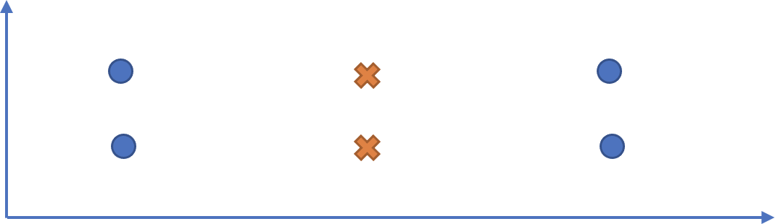
Convergence of 𝑘-means heavily depends on the initial pick of centroids. It can perform arbitrarily badly:
Different strategies for picking 𝑘 centers:
Pick 𝑘 datapoints at random
▪ 𝑘-means ++
Jure Leskovec, Stanford CS246: Mining Massive Datasets

Slide 65
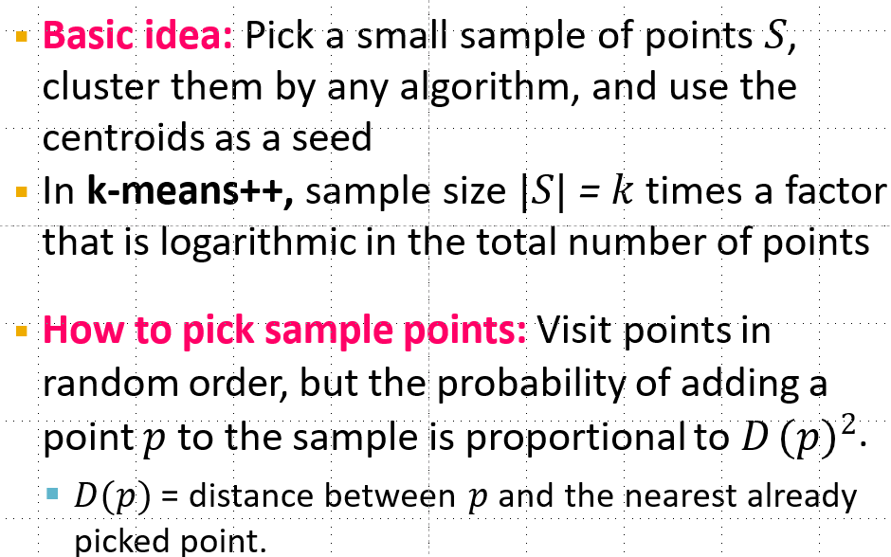
k–means++

Slide 66
The BFR Algorithm
Extension of k-means to large data

Slide 67
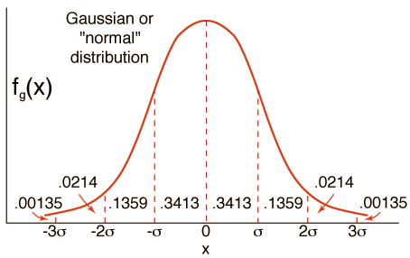
BFR Algorithm
BFR [Bradley-Fayyad-Reina] is a variant of k-means designed to handle very large (disk-resident) data sets
Assumes that clusters are normally distributed around a centroid in a Euclidean space
Standard deviations in different dimensions may vary
Clusters are axis-aligned ellipses
Goal is to find cluster centroids; point assignment can be done in a second pass through the data.

Slide 68

Efficient way to summarize clusters: Want memory required O(clusters) and not O(data)
IDEA: Rather than keeping points, BFR keeps summary statistics of groups of points
3 sets: Discard set, Compressed set, Retained set
Overview of the algorithm:
1. Initialize K clusters/centroids
2. Load in a bag of points from disk
3. Assign new points to one of the K original clusters, if they
are within some distance threshold of the cluster
4. Cluster the remaining points, and create new clusters
5. Try to merge new clusters from step 4 with any of the existing clusters
6. Repeat steps 2-5 until all points are examined

Slide 69
BFR Algorithm
Points are read from disk one main-memory-full at a time
Most points from previous memory loads are summarized by simple statistics
Step 1: To begin, from the initial load we select the initial k centroids by some sensible approach:
Take k random points
Take a small random sample and cluster optimally
Take a sample; pick a random point, and then k–1 more points, each as far from the previously selected points as possible

Slide 70
Three Classes of Points
3 sets of points which we keep track of:
Discard set (DS):
Points close enough to a centroid to be summarized
Compression set (CS):
Groups of points that are close together but not close to any existing centroid
These points are summarized, but not assigned to a cluster
Retained set (RS):
Isolated points waiting to be assigned to a compression set

Slide 71
BFR: “Galaxies” Picture
Points in
the RS
Compressed sets.
Their points are in
the CS.
A cluster. Its points
are in the DS.
The centroid
Discard set (DS): Close enough to a centroid to be summarized
Compression set (CS): Summarized, but not assigned to a cluster
Retained set (RS): Isolated points

Slide 72
Summarizing Sets of Points
For each cluster, the discard set (DS) is summarized by:
The number of points, N
The vector SUM, whose i^{th} component is the sum of the coordinates of the points in the i^{th} dimension
The vector SUMSQ: i^{th} component = sum of squares of coordinates in i^{th} dimension
A cluster. All its points are in the DS.
The centroid

Slide 73
Summarizing Points: Comments
2d + 1 values represent any size cluster
d = number of dimensions
Average in each dimension (the centroid) can be calculated as SUM_{i} / N
SUM_{i} = i^{th} component of SUM
Variance of a cluster’s discard set in dimension i is: (SUMSQ_{i} / N) – (SUM_{i} / N)²
And standard deviation is the square root of that
Next step: Actual clustering
Note: Dropping the “axis-aligned” clusters assumption would require storing full covariance matrix to summarize the cluster. So, instead of SUMSQ being a d-dim vector, it would be a d x d matrix, which is too big!

Slide 74
Steps 3-5) Processing “Memory-Load” of points:
Step 3) Find those points that are “sufficiently close” to a cluster centroid and add those points to that cluster and the DS
These points are so close to the centroid that they can be summarized and then discarded
Step 4) Use any in-memory clustering algorithm to cluster the remaining points and the old RS
Clusters go to the CS; outlying points to the RS
Discard set (DS): Close enough to a centroid to be summarized.
Compression set (CS): Summarized, but not assigned to a cluster
Retained set (RS): Isolated points

Slide 75
Steps 3-5) Processing “Memory-Load” of points:
Step 5) DS set: Adjust statistics of the clusters to account for the new points
Add Ns, SUMs, SUMSQs
Consider merging compressed sets in the DS
If this is the last round, merge all compressed sets in the CS and all RS points into their nearest cluster
Discard set (DS): Close enough to a centroid to be summarized.
Compression set (CS): Summarized, but not assigned to a cluster
Retained set (RS): Isolated points

Slide 76
A Few Details…
Q1) How do we decide if a point is “close enough” to a cluster that we will add the point to that cluster?
Q2) How do we decide whether two compressed sets (CS) deserve to be combined into one?

Slide 77
How Close is Close Enough?
Q1) We need a way to decide whether to put a new point into a cluster (and discard)
BFR suggests two ways:
The Mahalanobis distance is less than a threshold
High likelihood of the point belonging to currently nearest centroid

Slide 78
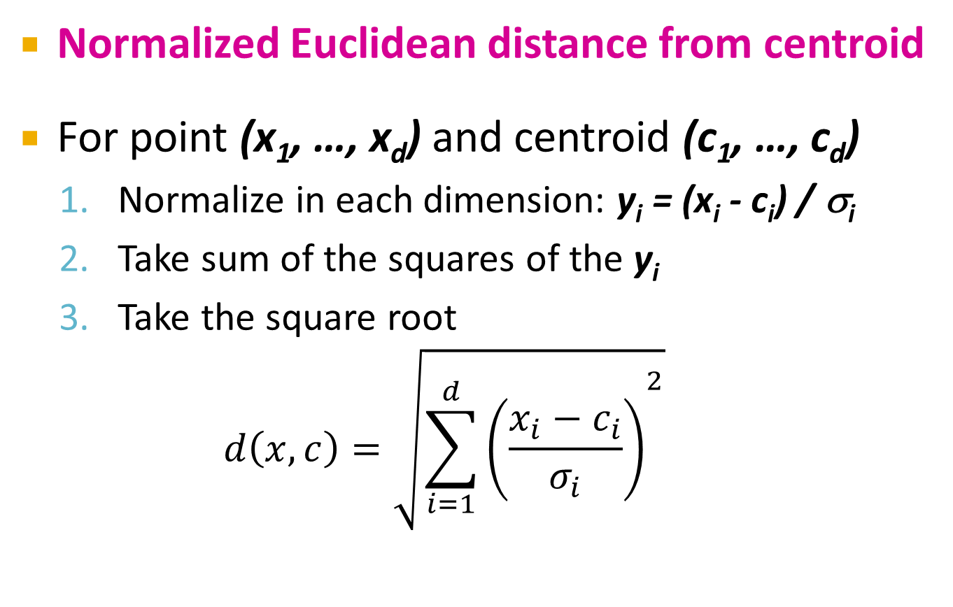
Mahalanobis Distance
Normalized Euclidean distance from centroid
For point (x₁, …, x_{d}) and centroid (c₁, …, c_{d})
Normalize in each dimension: y_{i} = (x_{i} - c_{i}) / σ_{i}
Take sum of the squares of the y_{i}
Take the square root
$$d\left(x,c\right)=\sqrt{{\sum_{i=1}^{d}{\left(\frac{x_{i}−c_{i}}{σ_{i}}\right)}}^{2}}$$
σ_{i} … standard deviation of points in the cluster in the i^{th} dimension

Slide 79
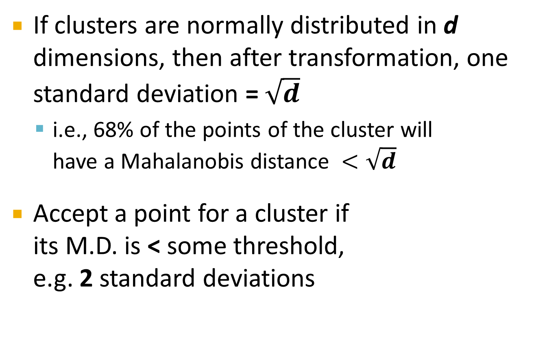
Mahalanobis Distance
If clusters are normally distributed in d dimensions, then after transformation, one standard deviation = $\sqrt{d}$
i.e., 68% of the points of the cluster will have a Mahalanobis distance $<\sqrt{d}$
Accept a point for a cluster if its M.D. is < some threshold, e.g. 2 standard deviations

Slide 80
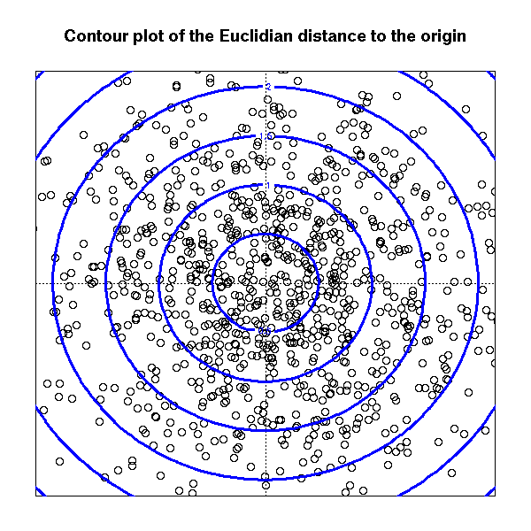
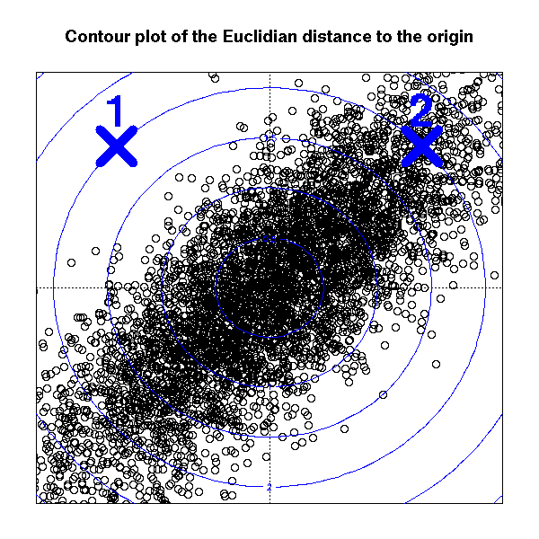
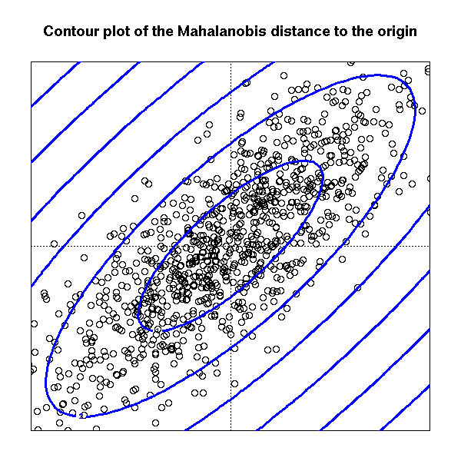
Picture: Equal M.D. Regions
Euclidean vs. Mahalanobis distance
Contours of equidistant points from the origin
Uniformly distributed points, Euclidean distance
Normally distributed points, Euclidean distance
Normally distributed points, Mahalanobis distance

Slide 81
Should 2 CS clusters be combined?
Q2) Should 2 CS subclusters be combined?
Compute the variance of the combined subcluster
N, SUM, and SUMSQ allow us to make that calculation quickly
Combine if the combined variance is below some threshold
Many alternatives: Treat dimensions differently, consider density

Slide 82
The CURE Algorithm
Extension of k-means to clusters of arbitrary shapes

Slide 83
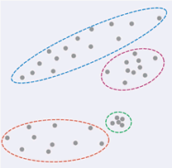
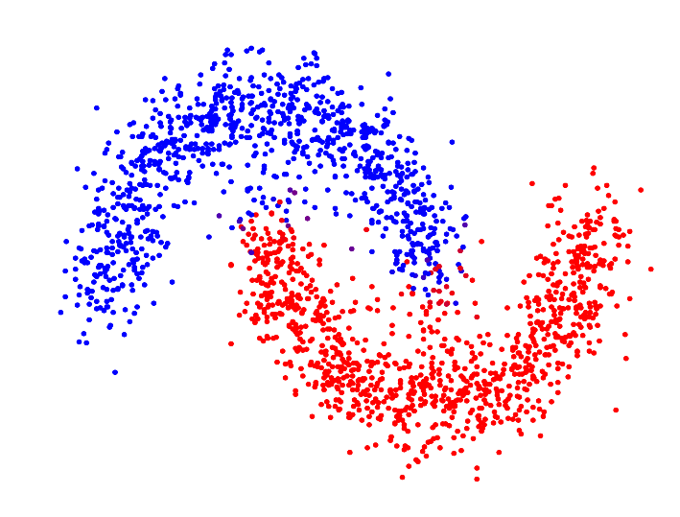
The CURE Algorithm
Vs.
Problem with BFR/k-means:
Assumes clusters are normally distributed in each dimension
And axes are fixed – ellipses at an angle are not OK
CURE (Clustering Using REpresentatives):
Assumes a Euclidean distance
Allows clusters to assume any shape
Uses a collection of representative points to represent clusters

Slide 84
Example: Stanford Salaries
h
h
h
e
e
e
h
e
e
e
h
e
e
e
e
salary
h
e
h
h
h
h
h
h
h
age

Slide 85
Starting CURE
2 Pass algorithm. Pass 1:
0) Pick a random sample of points that fit in main memory
1) Initial clusters:
Cluster these points hierarchically – group nearest points/clusters
2) Pick representative points:
For each cluster, pick a sample of points, as dispersed as possible
From the sample, pick representatives by moving them (say) 20% toward the centroid of the cluster

Slide 86
Example: Initial Clusters
h
h
h
e
e
e
h
e
e
e
h
e
e
e
e
h
salary
e
h
h
h
h
h
h
h
age

Slide 87
Example: Pick Dispersed Points
h
h
h
e
e
e
h
e
e
e
h
e
e
e
e
h
salary
e
Pick (say) 4
remote points
for each
cluster.
h
h
h
h
h
h
h
age

Slide 88
Example: Pick Dispersed Points
h
h
h
e
e
e
h
e
e
e
h
e
e
e
e
h
salary
e
Move points
(say) 20%
toward the
centroid.
h
h
h
h
h
h
h
age

Slide 89
Finishing CURE
Pass 2:
Now, rescan the whole dataset and visit each point p in the data set
Place it in the “closest cluster”
Normal definition of “closest”: Find the closest representative to p and assign it to representative’s cluster
p

Slide 90

Intuition:
If initial sample is large enough, some of the representatives will be on the boundary of clusters
Moving them towards centroid, move them inside
A large, dispersed cluster will have larger moves as opposed to a small, dense cluster
Favors a small, dense cluster that is near a larger dispersed
cluster

Slide 91
Summary
Clustering: Given a set of points, with a notion of distance between points, group the points into some number of clusters
Algorithms:
Agglomerative hierarchical clustering:
Centroid and clustroid
k-means:
Initialization, picking k
BFR
CURE

